Slide 1

CORONA VIRUS ANALYSIS WITH SQL
NAME – PRIYA KUMARI
BATCH - MIP-DA-11

Slide 2

INDEX
INTRODUCTION
PROBLEM STATEMENT
DATASET
DATA WRANGLING
BUSINESS QUESTIONS TO ANSWER
INSIGHTS

Slide 3

INTRODUCTION
The COVID pandemic, caused by the SARS-CoV-2 virus, has led to unprecedented global challenges.
Data provides critical insights for decision-making and policy development.
Accurate and timely data helps track infection rates, hospitalizations, recoveries.
SQL is a versatile tool that can help manage and analyze COVID data efficiently.
By setting up a database and using SQL queries, you can gain valuable insights into the spread of the virus, the impact of vaccinations, and other critical aspects of the pandemic.

Slide 4

PROBLEM STATEMENT
The CORONA VIRUS pandemic has had a significant impact on public health and has created an urgent need for data-driven insights to understand the spread of the virus. As a data analyst, you have been tasked with analyzing a CORONA VIRUS dataset to derive meaningful insights and present your findings.

Slide 5

DATASET
Description of each column in dataset:
Province: Geographic subdivision within a country/region.
Country/Region: Geographic entity where data is recorded.
Latitude: North-south position on Earth's surface.
Longitude: East-west position on Earth's surface.
Date: Recorded date of CORONA VIRUS data.
Confirmed: Number of diagnosed CORONA VIRUS cases.
Deaths: Number of CORONA VIRUS related deaths.
Recovered: Number of recovered CORONA VIRUS cases.

Slide 6
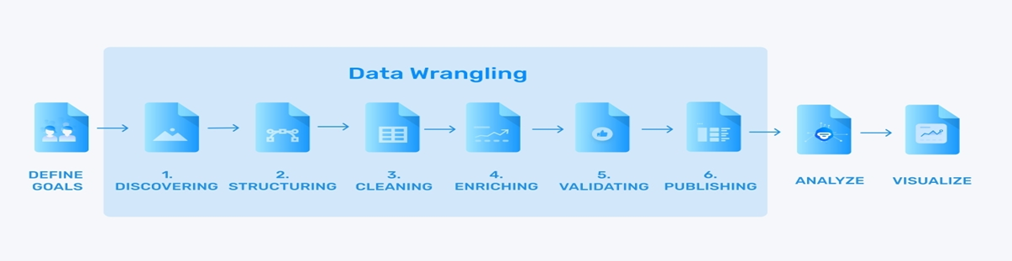

DATA WRANGLING
Data Wrangling is the process of converting raw data into a usable form.
It describes a series of processes designed to explore, transform, and validate raw datasets from their messy and complex forms into high-quality data.
This is the first step where inspection of data is done to make sure NULL values and missing values are detected and data replacement methods are used to replace missing or NULL values.
There are no NULL values in our dataset.

Slide 7

Business Questions To Answer
Q1. Write a code to check NULL values.
SELECT COUNT(*) as total_null_values
FROM corona_virus_dataset
WHERE Province IS NULL OR
'Country/Region' IS NULL OR
Latitude IS NULL OR Longitude IS NULL OR
Date IS NULL OR
Confirmed IS NULL OR
Deaths IS NULL OR
Recovered IS NULL;

Slide 8
Business Questions To Answer
Q2. If NULL values are present, update them with zeros for all columns.
UPDATE corona_virus_dataset
SET Province = COALESCE(Province, '0'),
'Country/Region' = COALESCE('Country/Region', '0'),
Latitude = COALESCE(Latitude, '0'),
Longitude = COALESCE(Longitude, '0'),
Date = COALESCE(Date, '0'),
Confirmed = COALESCE(Confirmed, '0'),
Deaths = COALESCE(Deaths, '0'),
Recovered = COALESCE(Recovered, '0') WHERE ID > 0;
OUTPUT- NO NULL VALUES ARE PRESENT IN THE GIVEN DATASET.

Slide 9


Business Questions To Answer
Q3. Check total number of rows.
SELECT COUNT(*) FROM corona_virus_dataset;
Q4. Check what is start_date and end_date.
SELECT min(Date) as Start_Date, max(Date) as End_Date FROM corona_virus_dataset;

Slide 10

Business Questions To Answer
Q5. Number of month present in dataset.
SELECT YEAR(Date) as Year,
COUNT(DISTINCT MONTH (Date)) as number_of_months FROM corona_virus_dataset
GROUP BY YEAR(Date);

Slide 11
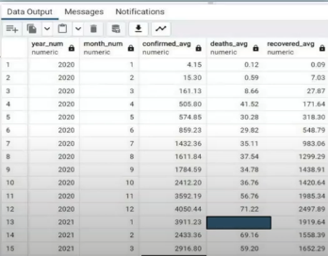
Business Questions To Answer
Q6.Find monthly average for confirmed, deaths, recovered.
SELECT YEAR(Date) as year_num, MONTH(Date) as month_num, AVG(Confirmed) as confirmed_avg,
AVG(Deaths) as deaths_avg,
AVG(Recovered) as recovered_avg
FROM corona_virus_dataset GROUP BY year_num,month_num;

Slide 12
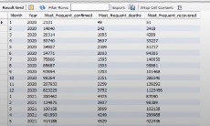
Business Questions To Answer
Q7. Find most frequent value for confirmed, deaths, recovered each month.
SELECT MONTH(Date) as Month, YEAR(Date) as Year, MAX(Confirmed) as Most_frequent_confirmed,
MAX(Deaths) as Most_frequent_deaths ,
MAX(Recovered) as Most_frequent_recovered FROM corona_virus_dataset GROUP BY Month(Date), Year(Date);

Slide 13
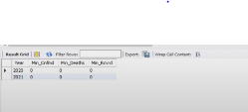
Business Questions To Answer
Q8. Find minimum values for confirmed, deaths, recovered per year.
SELECT YEAR('Date') as Year,
MIN(Confirmed) as Min_Cnfmd,
MIN(Deaths) as Min_Deaths,
MIN(Recovered) as Min_Rcvrd
FROM corona_virus_dataset GROUP BY Year;

Slide 14
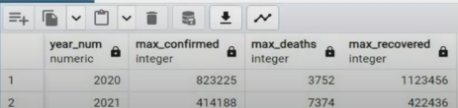
Business Questions To Answer
Q9. Find maximum values of confirmed, deaths, recovered per year.
SELECT YEAR('Date') as year_num,
MAX(Confirmed) as max_confirmed,
MAX(Deaths) as max_deaths,
MAX(Recovered) as max_recovered
FROM corona_virus_dataset GROUP BY year_num;

Slide 15
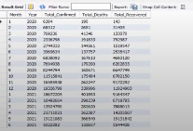
Business Questions To Answer
Q10. The total number of case of confirmed, deaths, recovered each month.
SELECT MONTH(Date) as Month, YEAR(Date) as Year, SUM(Confirmed) as Total_Confirmed,
SUM(Deaths) as Total_Deaths,
SUM(Recovered) as Total_Recovered
FROM corona_virus_dataset GROUP BY Month, Year;

Slide 16

Business Questions To Answer
Q11. Check how corona virus spread out with respect to confirmed case.
SELECT SUM(Confirmed) as Total_Confirmed,
AVG(Confirmed) as Average_Confirmed,
Round(Variance(Confirmed)) as Var_Confirmed,
Round(STDDEV(Confirmed)) as Standard_deviation
FROM corona_virus_dataset;

Slide 17
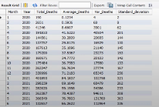
Business Questions To Answer
Q12. Check how corona virus spread out with respect to death case per month.
SELECT MONTH(Date) as Month, YEAR(Date) as Year,
SUM(Deaths) as Total_Deaths,
AVG(Deaths) as Average_Deaths,
Round(Variance(Deaths)) as Var_Deaths,
Round(STDDEV(Deaths)) as Standard_deviation
FROM corona_virus_dataset GROUP BY Month,Year;

Slide 18

Business Questions To Answer
Q13. Check how corona virus spread out with respect to recovered case.
SELECT SUM(Recovered) as Total_Recovered,
AVG(Recovered) as Average_Recovered,
Round(Variance(Recovered)) as Var_Recovered,
Round(STDDEV(Recovered)) as Standard_deviation
FROM corona_virus_dataset;

Slide 19
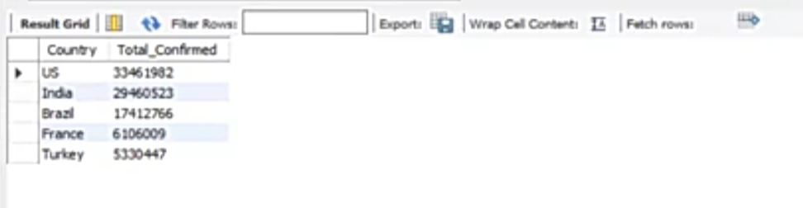
Business Questions To Answer
Q14. Find Country having highest number of the Confirmed case.
SELECT Country, SUM(Confirmed) as Total_Confirmed
FROM corona_virus_dataset
GROUP BY Country ORDER BY Total_Confirmed DESC LIMIT 5;

Slide 20
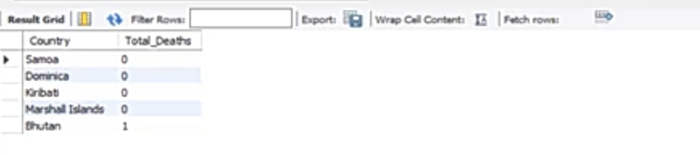
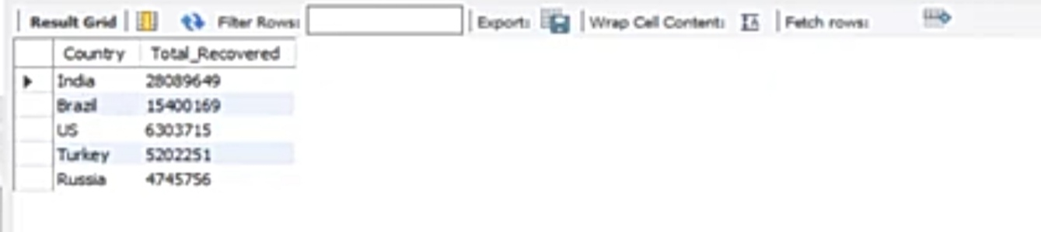
Business Questions To Answer
Q15. Find Country having lowest number of the death case.
SELECT Country, SUM(Deaths) as Total_Deaths FROM corona_virus_dataset GROUP BY Country ORDER BY Total_Deaths ASC LIMIT 5;
Q16. Find top 5 countries having highest recovered case.
SELECT Country, SUM(Recovered) as Total_Recovered FROM corona_virus_dataset GROUP BY Country ORDER BY Total_Recovered DESC LIMIT 5;

Slide 21
INSIGHTS
COVID-19 Pandemic duration : January 22,2020 to June 13,2021.
India has the highest number of recovered cases.
Samoa, Kiribati, Dominica and the Marshall Islands have the lowest death counts.
The US reported the highest number of confirmed COVID-19 cases.
Peak confirmed cases occurred in April 2021.
Peak death rate in January 2021.
The highest record of deaths in a single day was 7,374 in June.
The highest total confirmed cases in a single month was 2,40,47,819 in April.

Slide 22


